Slide 1
COP290 TASK2 PACMAN GAME
BY,
CH.SRIRAM VARMA
GAUTAMBUDDHA N MEESHI

Slide 2
About Our Game!
It’s a two player game , controlled by different set of keys. Viz.,
1st set of keys ( up, down, left, right ) and 2nd set are (W,A,S,D)
These two players will start at same place in the maze and will travel to get score
There are ghosts that chase pacman in the maze. If you get caught, you will become a ghost and can chase other player.
For scoring, there are different types of coins are distributed across the maze.

Slide 3
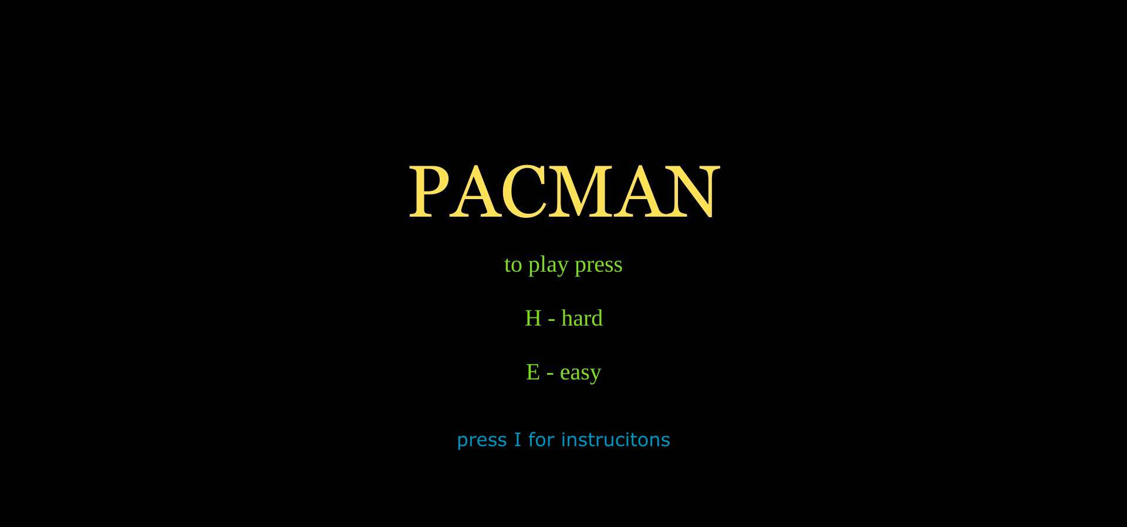
Home page of game!

Slide 4
Description of home page
In the before slide, you can see there are multiple options for starting the game:
1)If you want to play in hard mode then press H.
2)If you want to play in easy mode then press E.
3)If you want to read instructions then press I and if you want to go back to
home again then press Y.

Slide 5
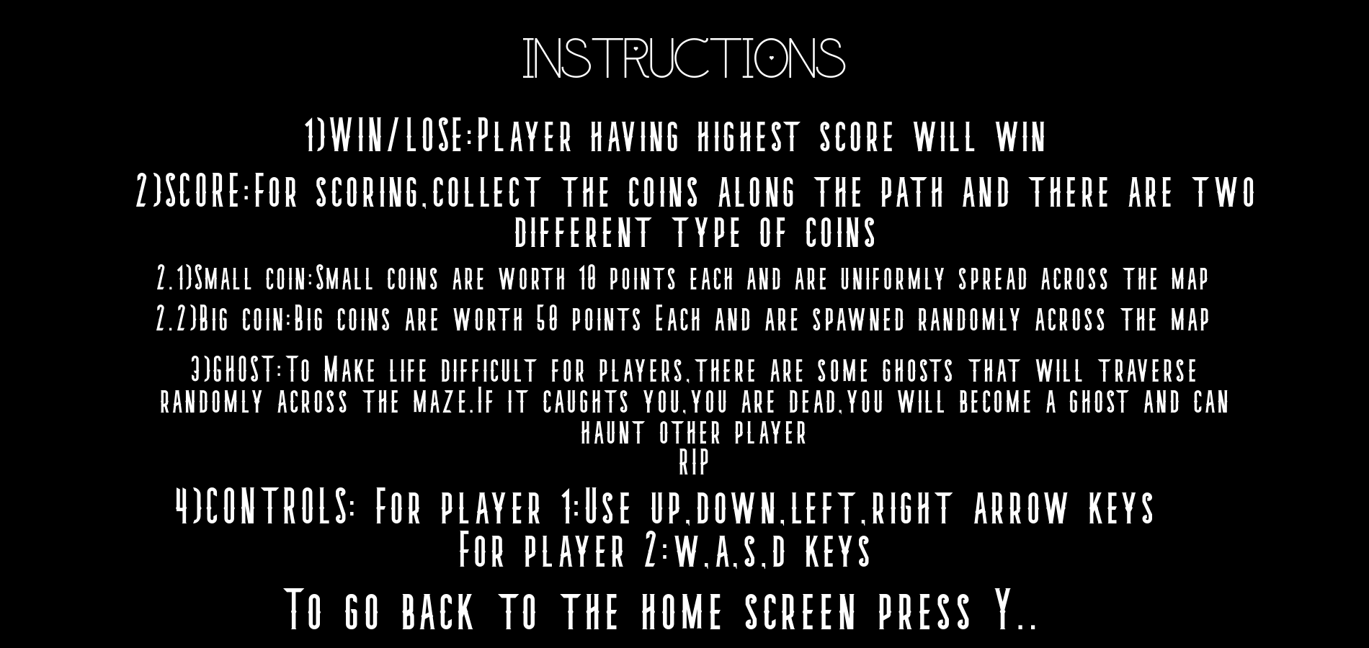
Instructions page

Slide 6
GAME MODES!
Hard: This game mode consists of 4 ghosts that chases pacman. In these 4 ghosts, 2 ghosts will chase one pacman and other two will chase another pacman. As mentioned in instructions, if any player get caught he can chase other player.
Easy: This game mode consists of 2 ghosts that chases pacman. In these 2 ghosts, 1 ghost will chase one pacman and other will chase another pacman. As mentioned in instructions, if any player get caught he can chase other player.

Slide 7
Maze Generation
Algorithm for maze generation:
1) Initially, We spawn rectangles of various sizes along the left border
2) Then we will spawn more rectangles of random width along the each
row created initially.
3)For blocking some random paths that are generated , we will spawn 40x40 blocks in between them at random points.
Due to this maze algorithm there can be a case where we cant reach some places in the maze.

Slide 8
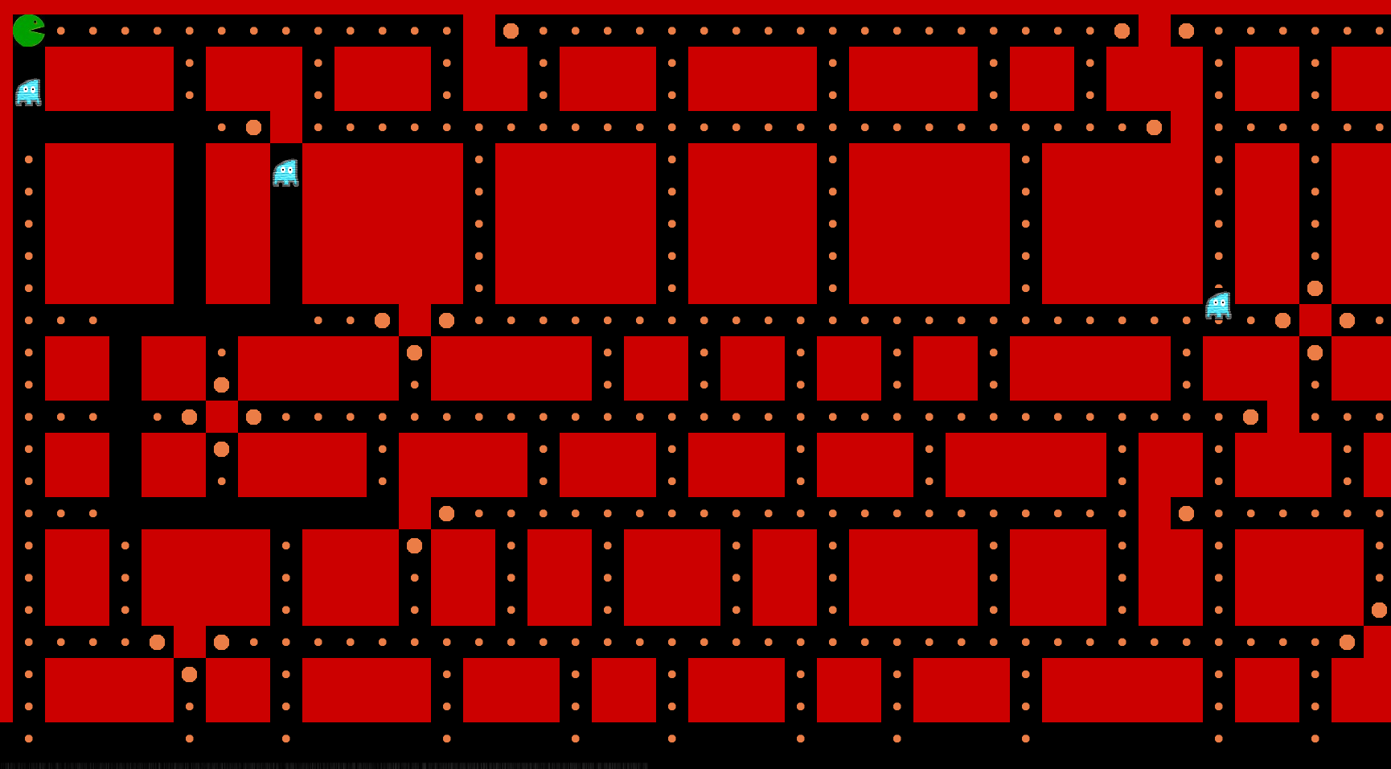
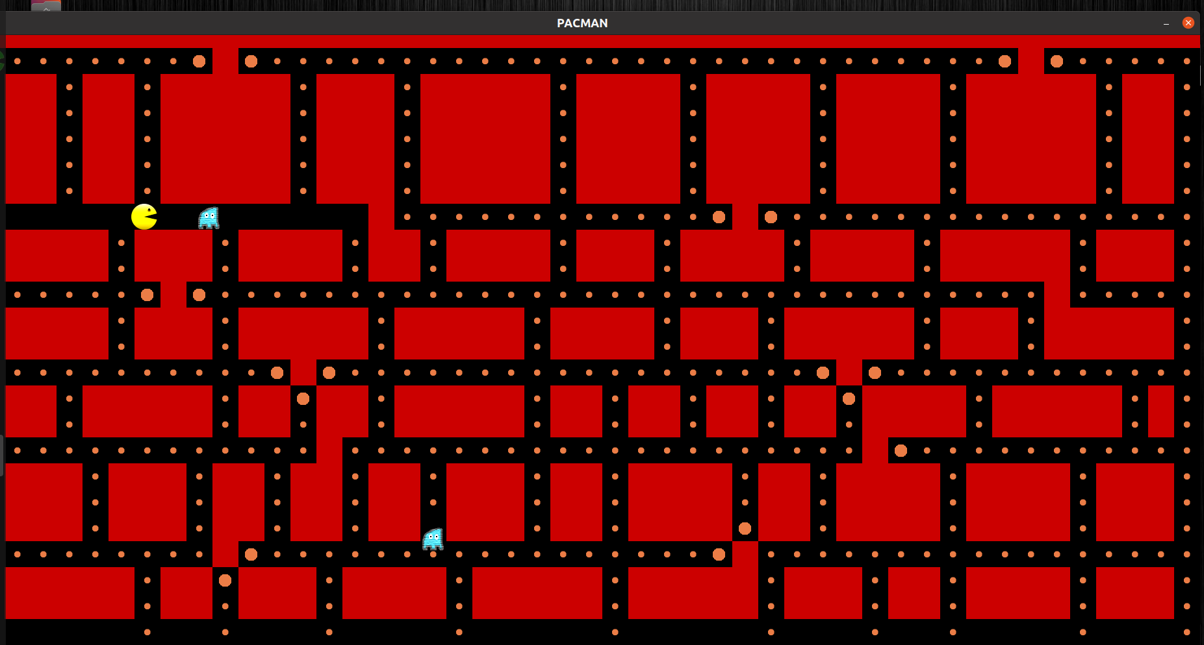
SOME PICTURES OF OUR GAME

Slide 9
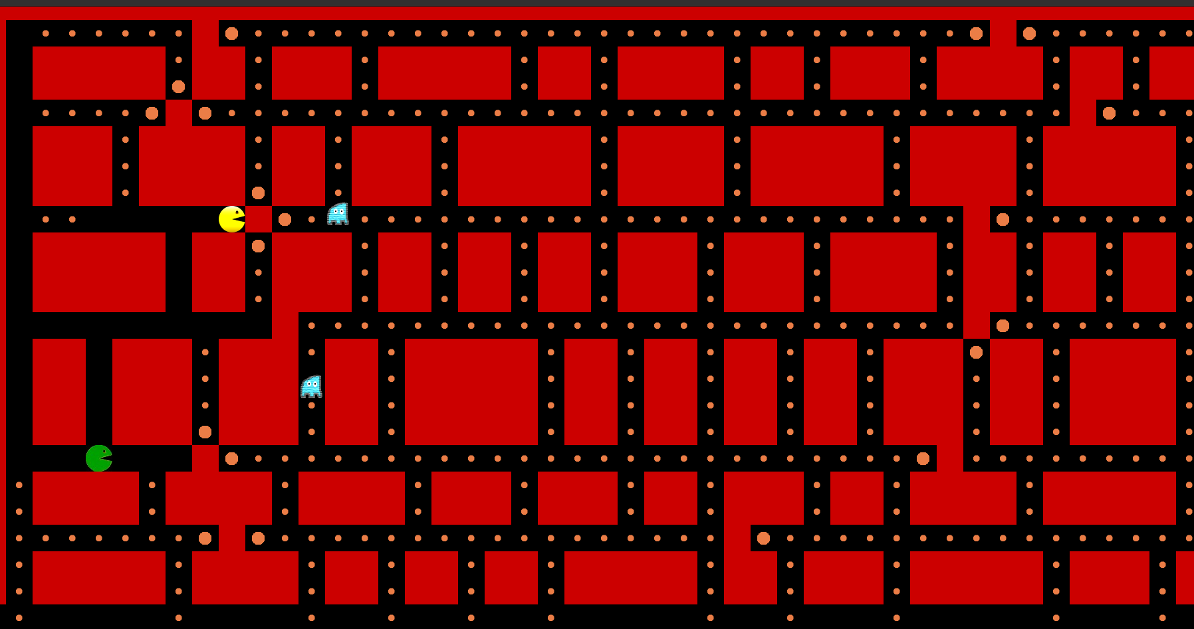
BLOCKED MAZE 1)Here you can see that maze is blocked to the right side. This happens very rarely 2)You have to speed run and scoop how much coins that are possible to win

Slide 10
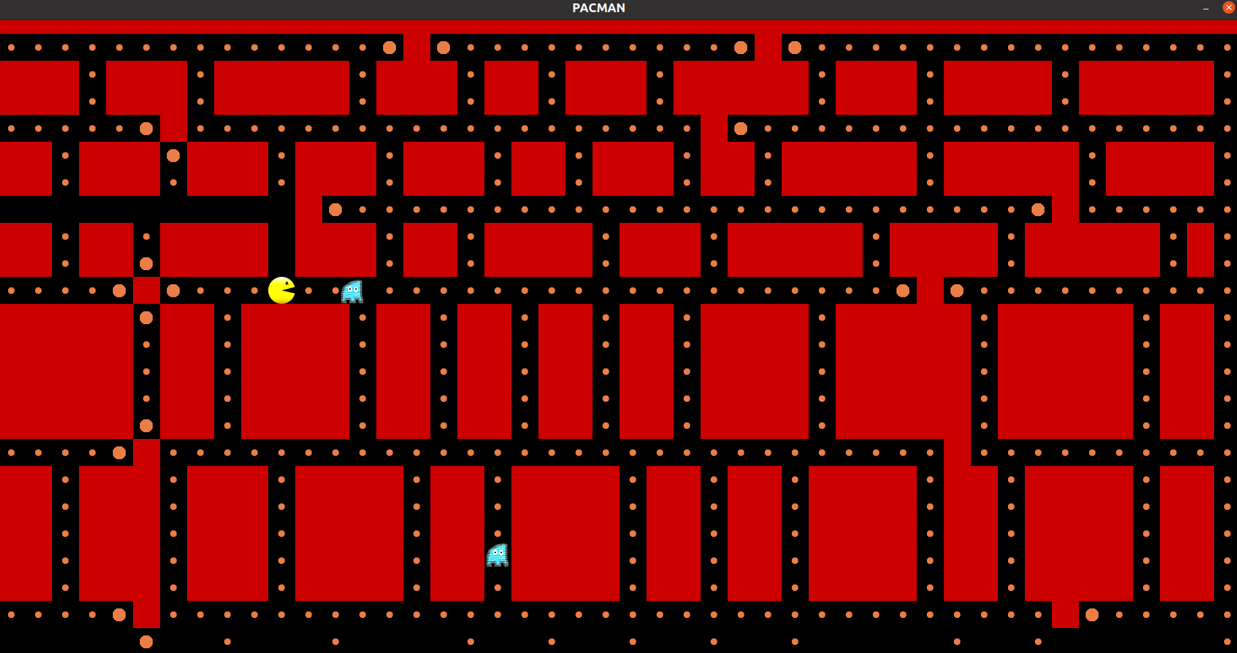
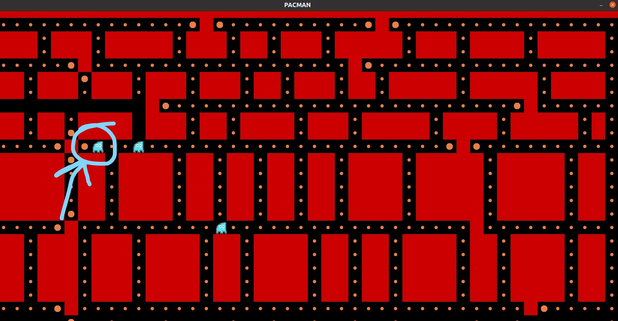
CONVERTING TO GHOST
Before getting caught by ghost After getting caught by ghost

Slide 11
WIN/LOSE CRITERIA
Player having higher score wins.
Once a player dies , he cant farm any more points in the ghost form. He can only chase other player.
There is also a time metric in the scoreboard, it shows for how much time a player didn’t get caught.

Slide 12
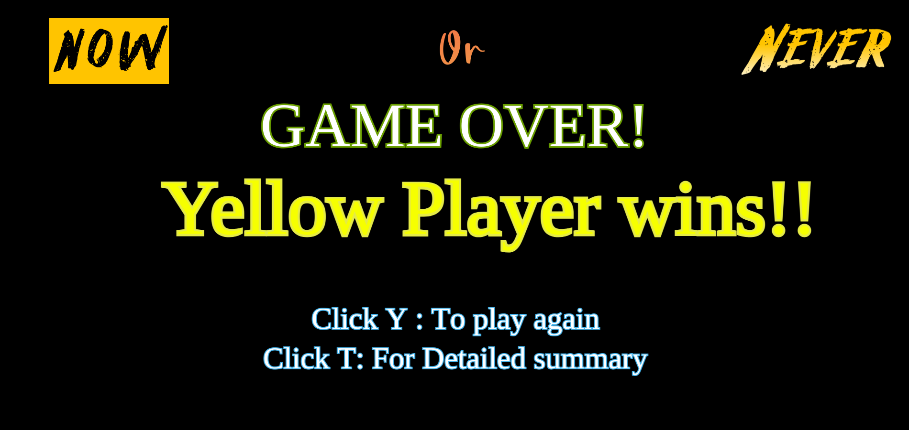
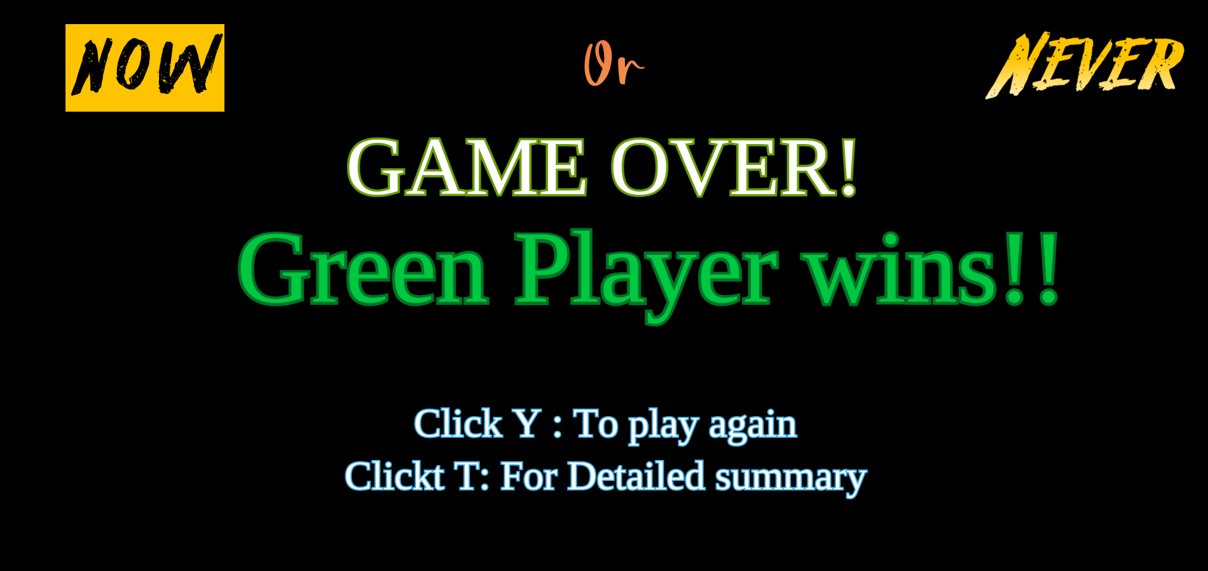
GAME OVER If both players died then game is finished
If yellow player wins If green player wins

Slide 13
GAMEOVER
In the game over screen, you can see there are some more options:
1)To Start game again you can press Y.
2)To watch Score board of your last game you can press T.

Slide 14
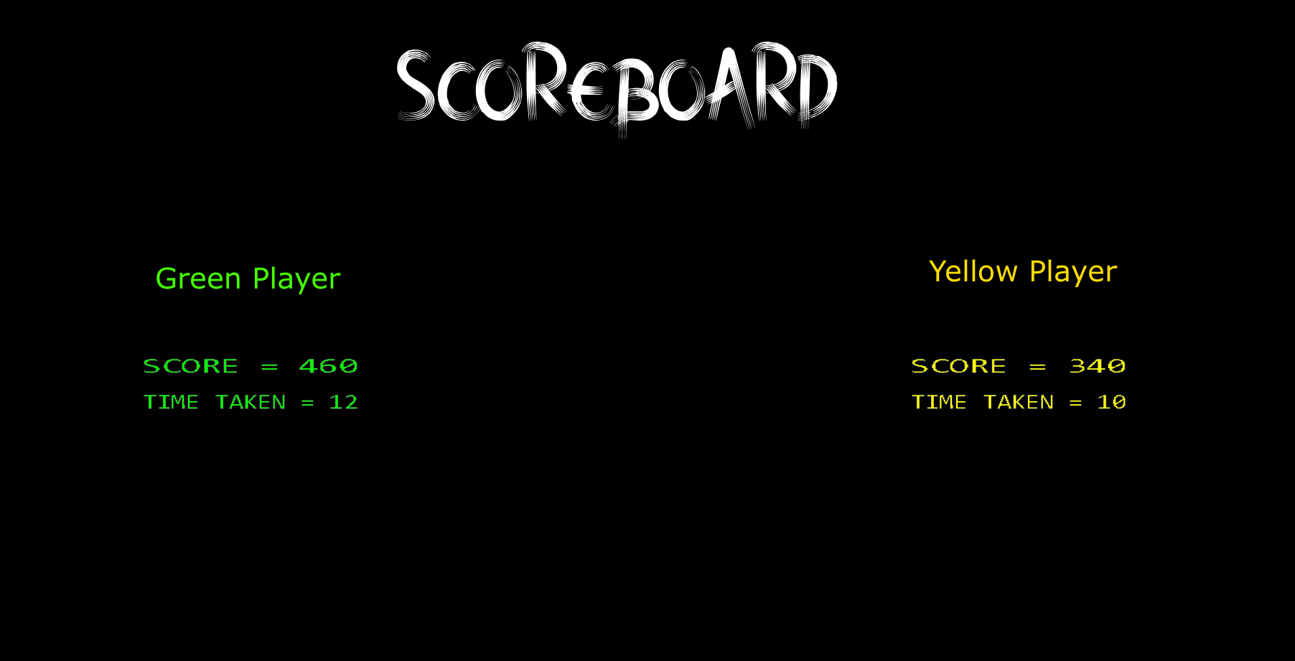
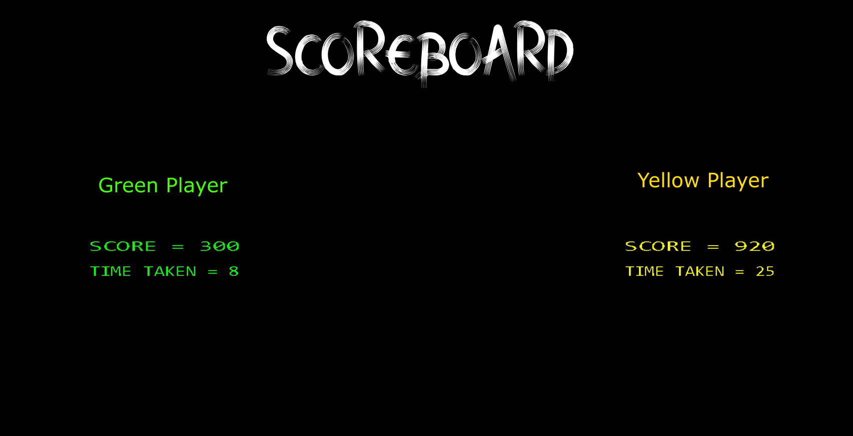
SCOREBOARD

Slide 15
SCOREBOARD
From the before slide , you can see scoreboard of both players this contains:
1)Score of each player
2)Survived time of each player

Slide 16
Other stuff!
We implemented game sounds for :
1) Game menu
2) In game sounds
3) Game over menu
We also tried implementing sockets but we faced problem in transfer the game data continuously. Our plan of using sockets was:
1)At the beginning , we want to send the maze structure using sockets. i.e., the coordinates and dimensions of the rectangles for maze.
2)while playing the game we want to send the coordinates of the ghosts and pacman.
3)Since rendering and movement of pacman was done locally.
We couldn’t implement sockets in given time.

Slide 17
Resources and packages Used
Resources:
1) https://lazyfoo.net/tutorials/SDL/index.php
2) https://github.com/maciejspychala/sdl-game
3) https://www.binarytides.com/socket-programming-c-linux-tutorial/
4) https://www.geeksforgeeks.org/socket-programming-in-cc-handling-multiple-clients-on-server-without-multi-threading/
5)For image editing: https://pixlr.com/x/
Packages:
1)For Installing SDL2: sudo apt install libsdl2-dev
2)For displaying images: sudo apt-get install libsdl2-image-dev
3)For sounds: sudo apt-get install libsdl2-mixer-dev
4)For fonts: sudo apt-get install libsdl2-ttf-dev

